Slide 1
Heart Disease Diagnostic Analysis

Slide 2
Introduction
Health is real wealth in the pandemic time we all realized the brute effects of covid-19 on all irrespective of any status. You are required to analyze this health and medical data for better future preparation.

Slide 3
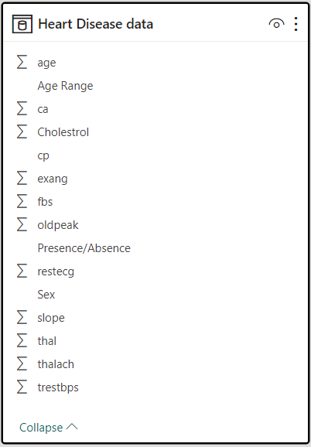
Details of data

Slide 4
Main Analysis
Heart Disease by Gender
Heart Disease by Age Group
Depression by Age
Heart Pain Experience

Slide 5
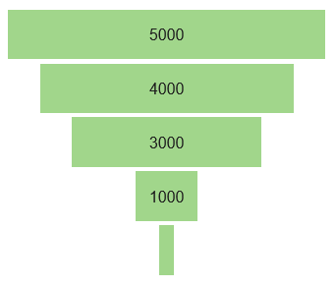
Mock – up Dashboard
Amazon sales Analysis
Page 1
Page 2
Avg
Total
KPI

Slide 6
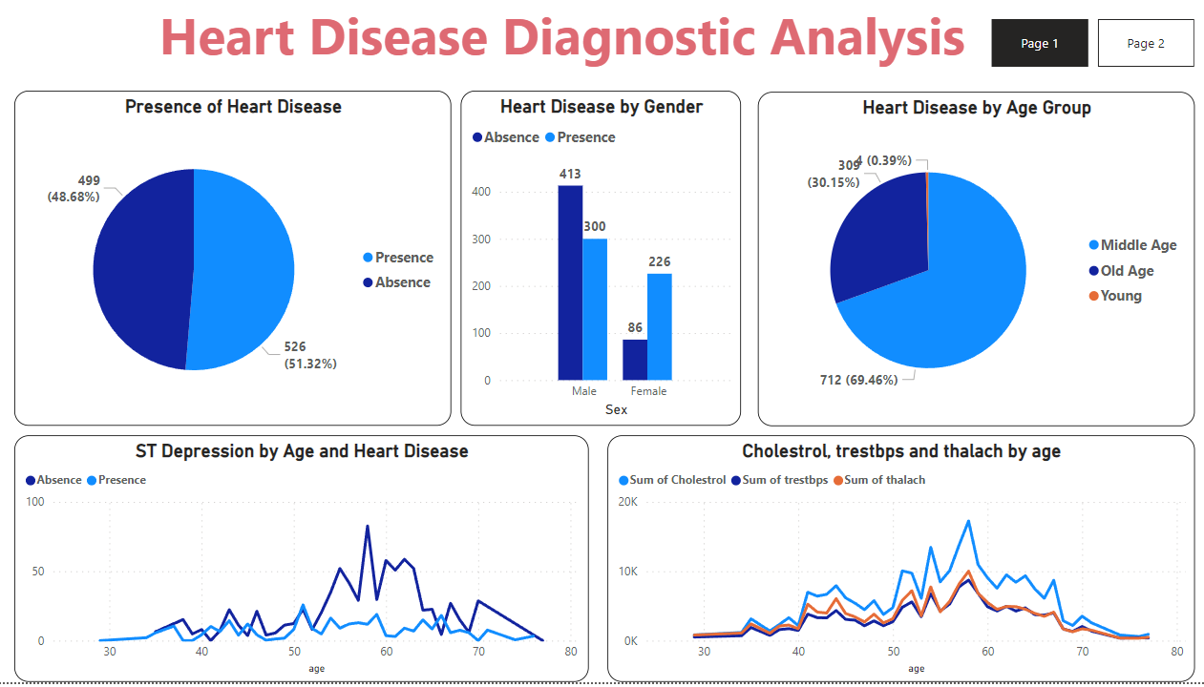
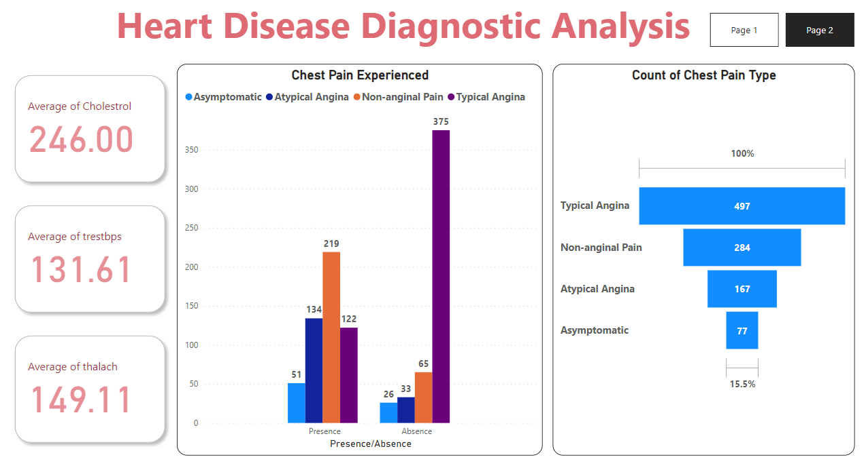
My Design

Slide 7
Thank You

